Slide 1
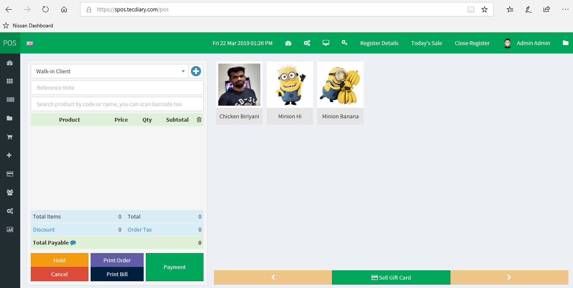
POS
https://www.youtube.com/watch?v=2QMrRXneIFU

Slide 2
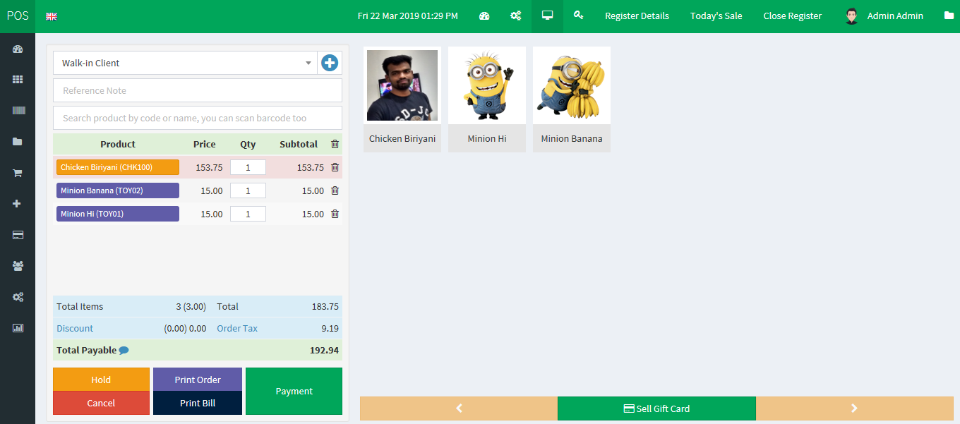
POS SELECTION COLOR

Slide 3
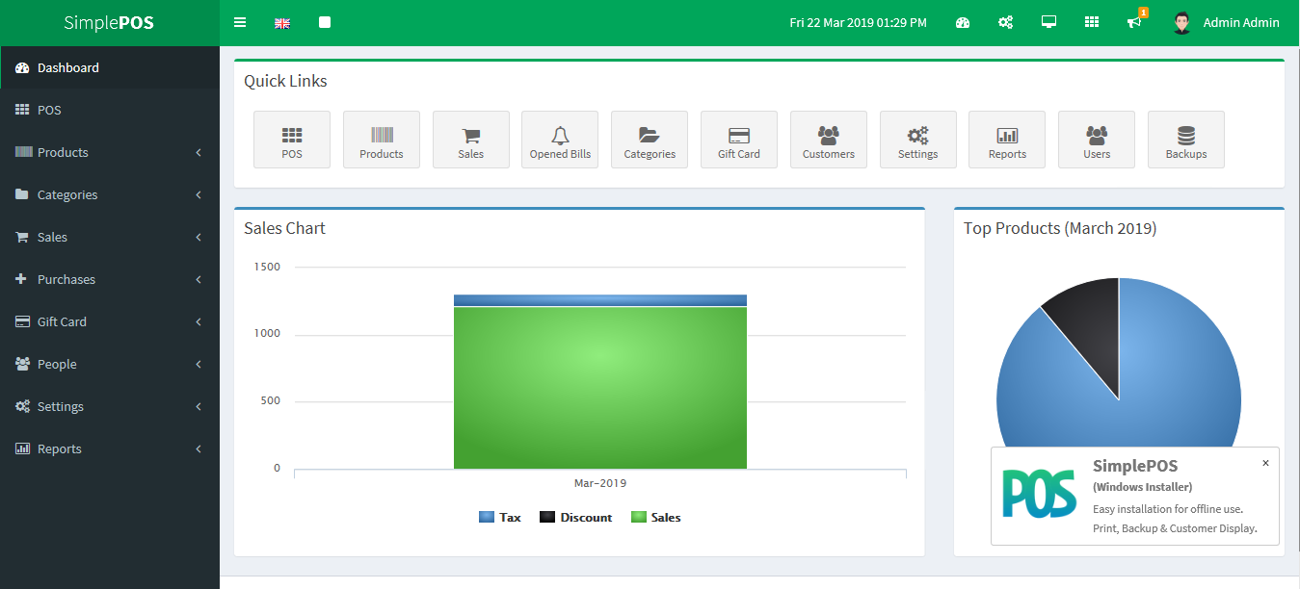
DASHBOARD

Slide 4
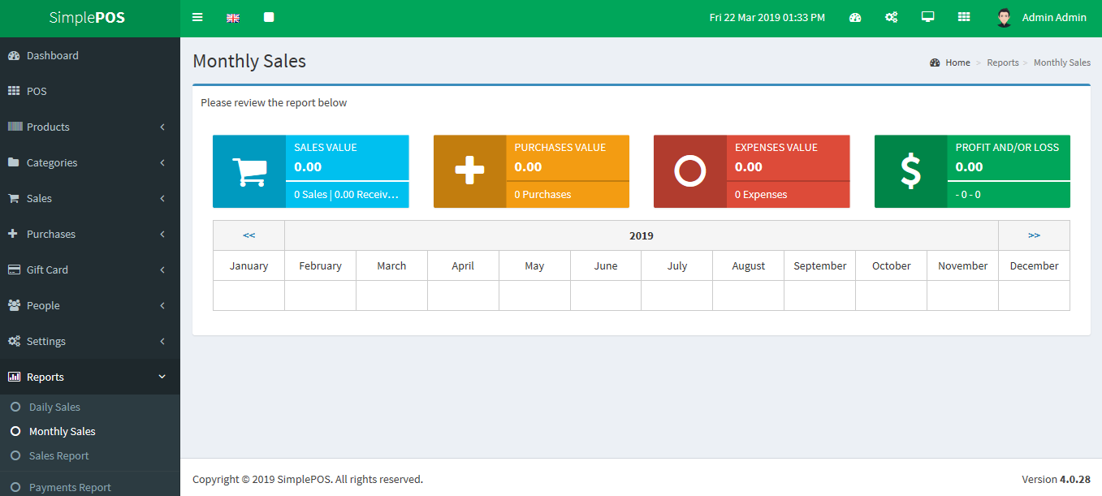
REPORTS MONTHLY SALES

Slide 5
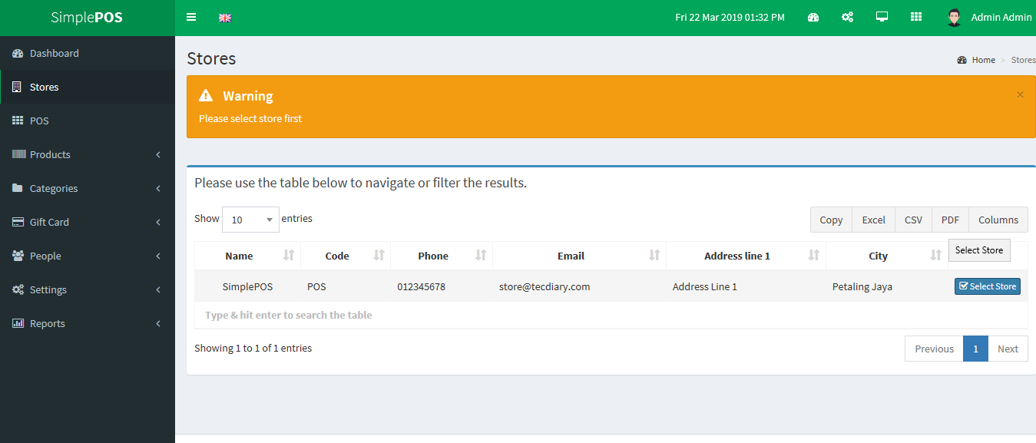
STORE PREVIEW

Slide 6
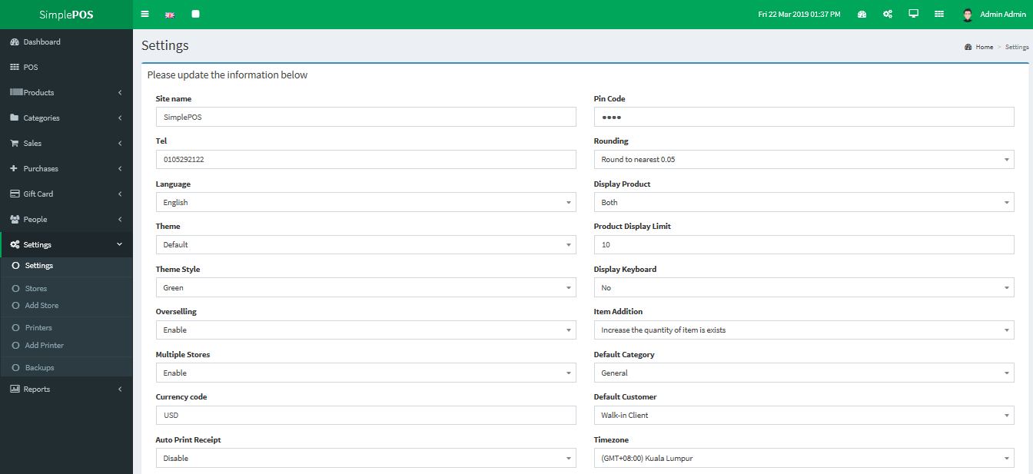
SETTING UP POS WEB

Slide 7
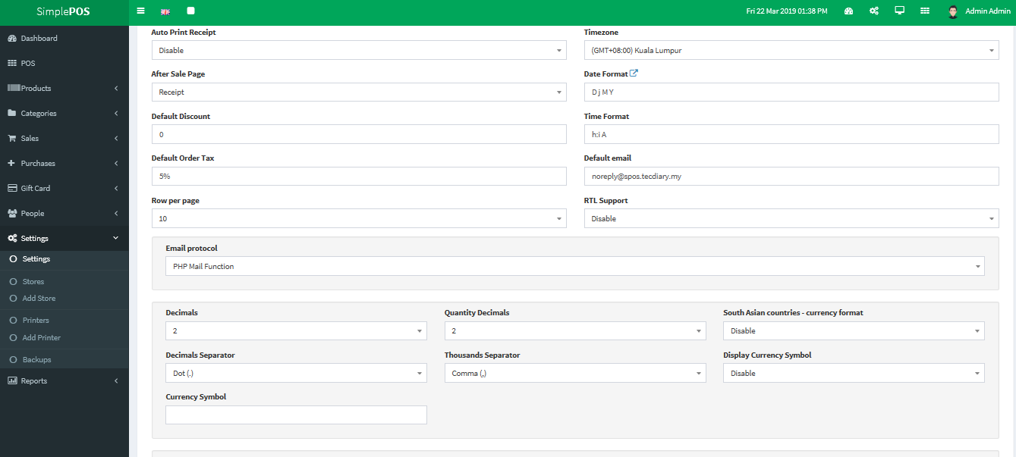

Slide 8
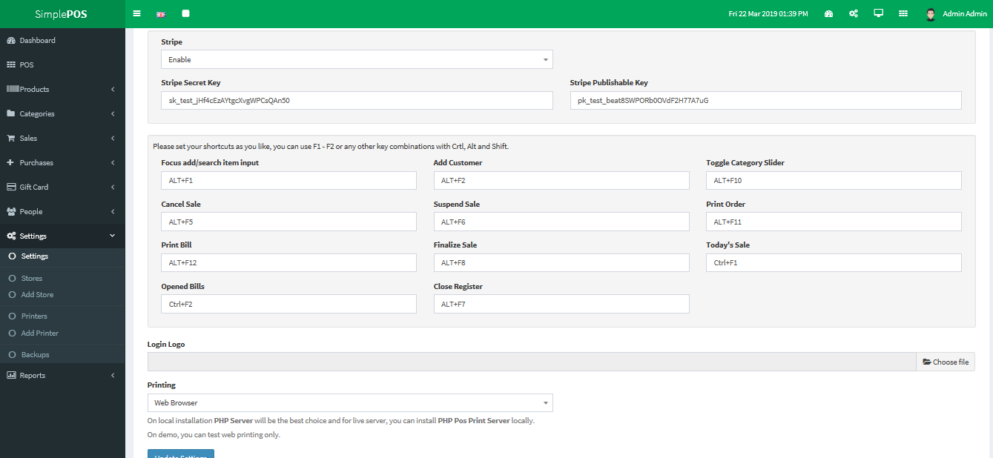

Slide 9
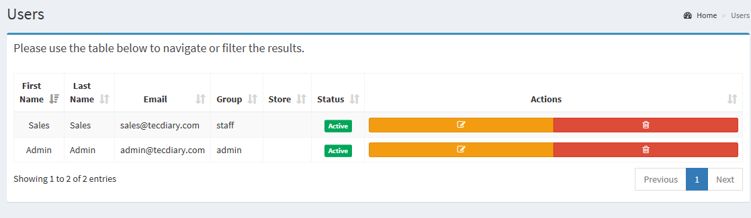
USERS ( active, edit )

Slide 10
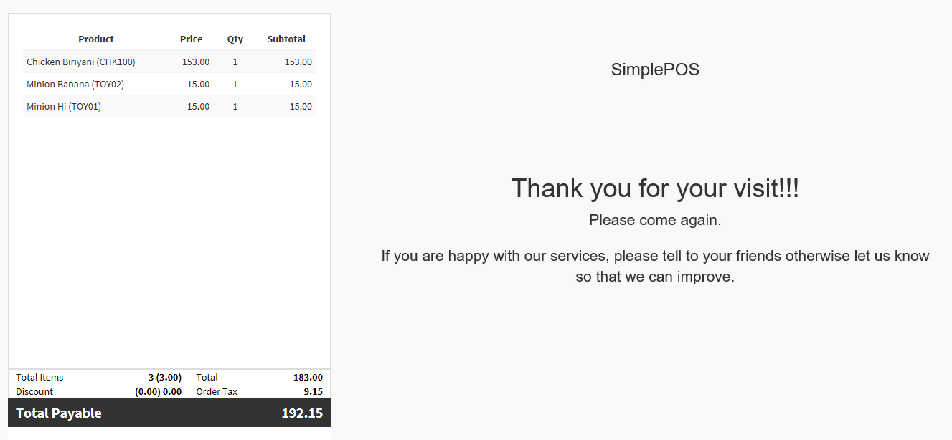
View Bill

